Slide 1
Welcome
CS 472/572
Unsupervised Machine Learning
PCA Analysis
Week-9 -Class -1
Fall 2025
Instructor: Dr. Khondker Fariha Hossain

Slide 2

Topics
Eigenvectors and eigenvalues
Variance and multivariate Gaussian distributions
Computing a covariance matrix from data
Principal Components Analysis (PCA)

Slide 3
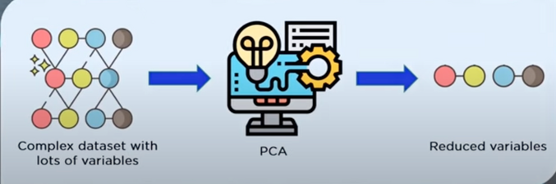
Introduction
Principal Component Analysis, commonly referred to as PCA, is a powerful mathematical technique used in data analysis and statistics. At its core, PCA is designed to simplify complex datasets by transforming them into a more manageable form while retaining the most critical information.
reducing the dimensionality of dataset
Increasing interpretability without losing information

Slide 4
Dimensionality Reduction
Dimensionality reduction refers to the techniques that reduce the number of input variables in a dataset.
Why DR?
Less dimensions for a given dataset means less computation or training time
Redundancy is removed after removing similar entries from the dataset
Data Compression (Reduce storage space)
It helps to find out the most significant features and skip the rest
Leads to better human interpretations

Slide 5
Why PCA?
Dimensionality Reduction
Noise Reduction
Visualization
Feature Engineering
Overfitting Problem
Data Compression
Machine Learning Processing

Slide 6
Important Terminologies
Variance
Covariance
Eigenvalues
Eigenvectors
Principle Component

Slide 7
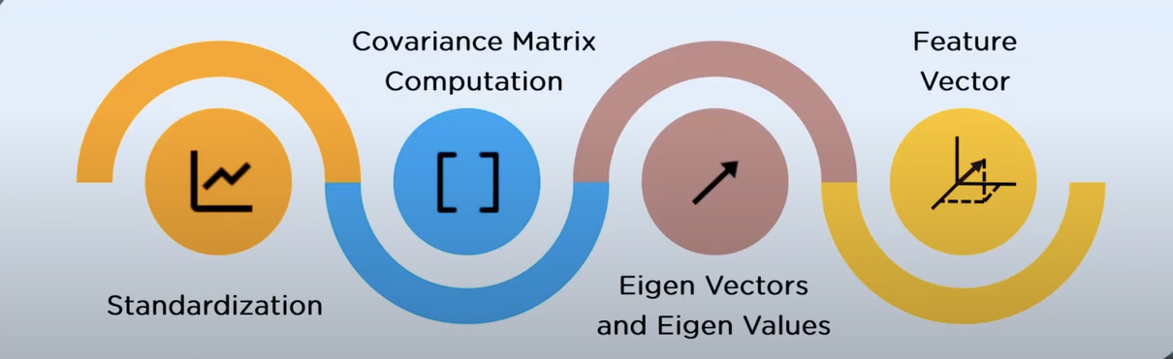
How does PCA work?
Step 1: Standardize the data.
Step 2: Calculate the covariance matrix.
Step 3: Compute the eigenvectors and eigenvalues.
Step 4: Select the principal components.
Step 5: Project data onto the new basis.

Slide 8
Principal Component Analysis
A mathematical procedure with simple matrix operations from linear algebra and statistics to transform a number of correlated variables into smaller number of uncorrelated variables called principal components.
Emphasize variation and bring out strong patterns in a dataset.
To make data easy to explore and visualize.
Still contains most of the information in the large set.

Slide 9
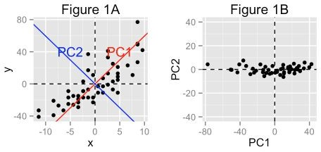
Figure 1A: The data are represented in the X-Y coordinate system
Figure 1B: The PC1 axis is the first principal direction along which the samples show the largest variation

Slide 10
Goals of PCA
To identify hidden pattern in a data set
To reduce the dimensionality of the data by removing the noise and redundancy in the data
To identify correlated variables

Slide 11
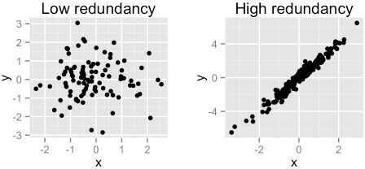
PCA method is particularly useful when the variables within the data set are highly correlated.
Correlation indicates that there is
redundancy in the data.
PCA can be used to reduce the original variables into a smaller number of new variables ( = principal components) explaining most of the variance in the original variables.

Slide 12
Steps to implement PCA in 2D dataset
Step 1: Normalize the data
Step 2: Calculate the covariance matrix
Step 3: Calculate the eigenvalues and eigenvectors
Step 4: Choosing principal components
Step 5: Forming a feature vector
Step 6: Forming Principal Components

Slide 13
Step 1: Normalization
This is done by subtracting the respective means from the numbers in the respective column. So if we have two dimensions X and Y, all X become 𝔁- and all Y become 𝒚-.
For all X; 𝔁- = X- μ_{x}
For all Y; 𝒚- = Y- μ_{y}
This produces a dataset whose mean is zero.

Slide 14
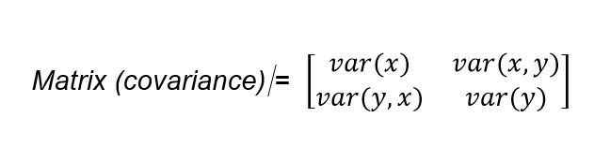
Step 2: Calculation of correlation
Covariance Matrix for Iris Dataset
 | Sepal.Length | Sepal.Width | Petal.Length | Petal.Width
Sepal.Length | 0.69 | -0.04 | 1.27 | 0.52
Sepal.Width | -0.04 | 0.19 | -0.33 | -0.12
Petal.Length | 1.27 | -0.33 | 3.12 | 1.30
Petal.Width | 0.52 | -0.12 | 1.30 | 0.58

Slide 15
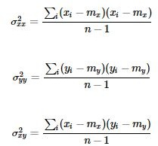
Calculation of correlation(contd...)
If x and y be two variables with length n,
The variance of x , variance of y and variance of x & y is given by following equations.
m_{x} : mean of x variables
m_{y} : mean of y variables

Slide 16
Correlation is the index to measure how strongly two variable are related to each other. The value of the same ranges for -1 to +1. (i.e. -1 < r < 1)
If r<0, variables are negatively correlated (e.g. x increases when y increases)
If r>0, variables are positively correlated (e.g. x increases when y decreases)
If r=0, variables has no correlation

Slide 17
Step 3: Calculation of Eigenvalue and Eigenvector
Calculate Eigenvalue and Eigenvector of the covariance matrix using power method:
|λ - AI| = 0
Where, I is an identity matrix of same dimension as A λ is eigenvalue.
For each value of λ, corresponding eigenvector ‘v’ is obtained by solving:
(λ - AI)v = 0

Slide 18
Step 4: Choosing Component
Eigenvalues from largest to smallest so that it gives us the components in order or significance.
If we have a dataset with n variables, then we have the corresponding n eigenvalues and eigenvectors.
Eigenvector (v) corresponding to largest eigenvalue (λ) is called first principal component.
To reduce the dimensions, we choose the first p
eigenvalues and ignore the rest.

Slide 19

Step 5: Forming a feature vector
Form a feature vector consists of selected eigenvectors
Feature Vector = (eig1, eig2)
NewData = FeatureVector^{T} x ScaledData^{T}
NewData is the Matrix consisting of the principal components,
FeatureVector is the matrix we formed using the eigenvectors we chose to keep, and
ScaledData is the scaled version of original dataset

Slide 20
Sample Implementation with sklearn
3
4
5
6
7
8
9
# Principal Component Analysis from numpy import array
from sklearn.decomposition import PCA # define a matrix
A = array([[1, 2], [3, 4], [5, 6]])
print(A)
# create the PCA instance pca = PCA(2)
# fit on data pca.fit(A)
# access values and vectors ie.covariance matrix
print(pca.components_) print(pca.explained_variance_) # transform data
B = pca.transform(A) print(B)
Output
[[1 2][3 4][5 6]]
10
11
12
13
14
15
16
[[ | 0.70710678 | 0.70710678]
[ | 0.70710678 | -0.70710678]]
[ 8.00000000e+00
2.25080839e-33]
[[ -2.82842712e+00
2.22044605e-16]
0.00000000e+00]
[ 0.00000000e+00 [ 2.82842712e+00
-2.22044605e-16]]

Slide 21
Applications of PCA
Commonly used dimensionality reduction technique in domains like
facial recognition, computer vision and image compression.
Used in finding patterns in data of high dimension in the field of
finance, data mining, bioinformatics, psychology.

Slide 22
Eigenvectors and eigenvalues

Slide 23
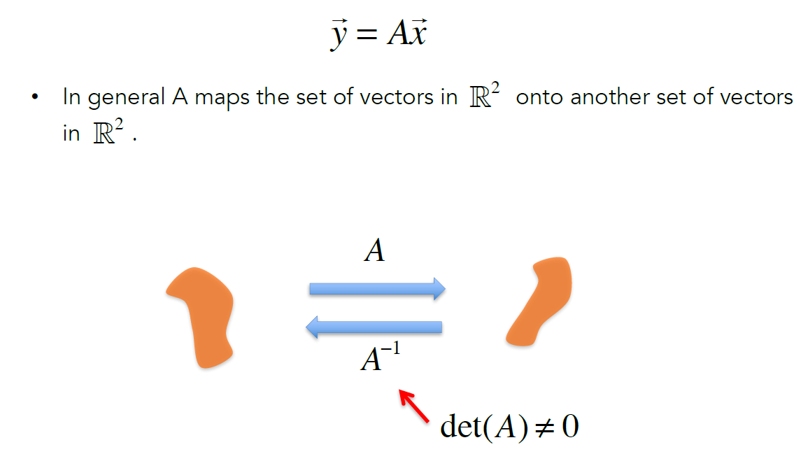

Matrix transformations

Slide 24
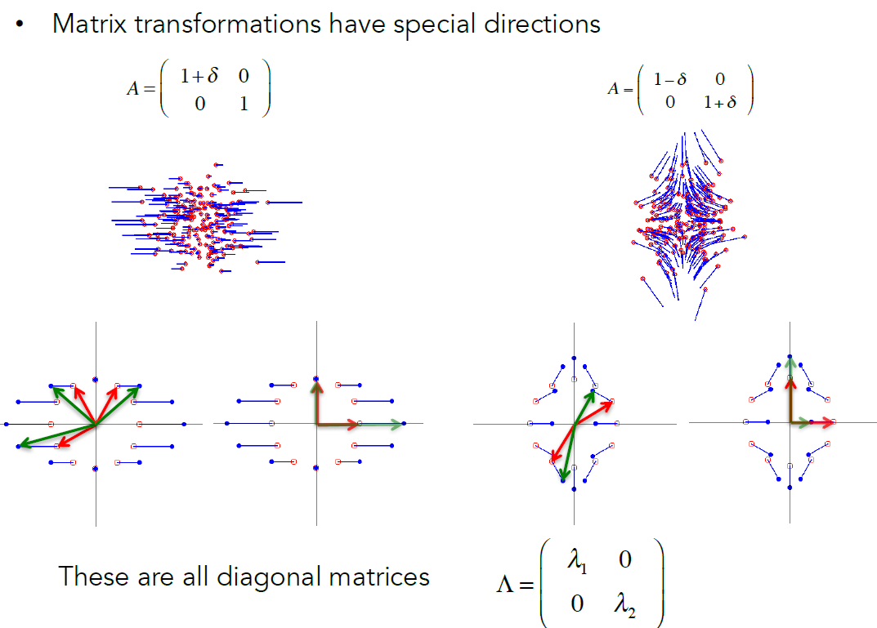

Eigenvectors and eigenvalues

Slide 25
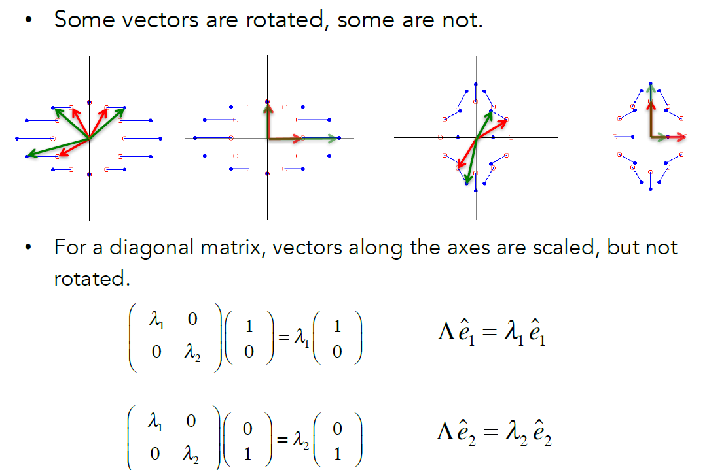
Eigenvectors and eigenvalues

Slide 26
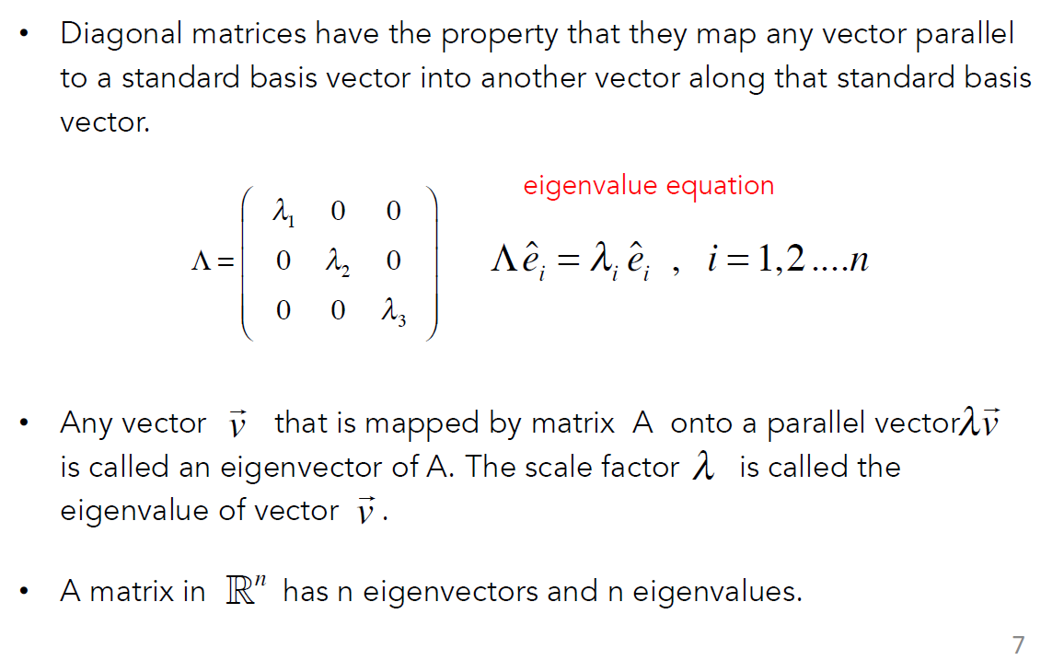
Eigenvectors and eigenvalues

Slide 27
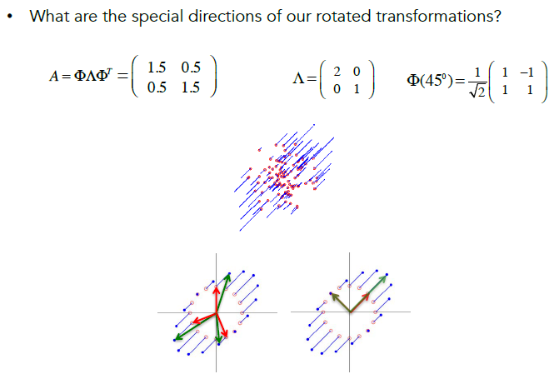
Eigenvectors and eigenvalues

Slide 28
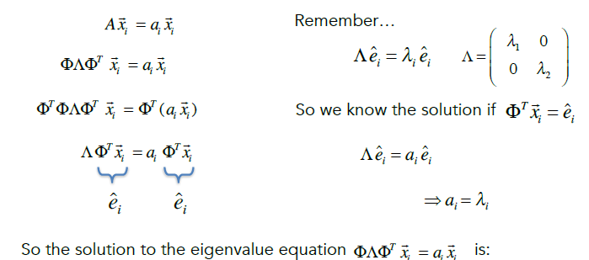


Eigenvectors and eigenvalues
What are the eigenvectors and eigenvalues of our rotated transformation matrix
eigenvalues
a_{i} = λ_{i}
eigenvectors
x_{i} = θeˆ_{i}
what is this?

Slide 29
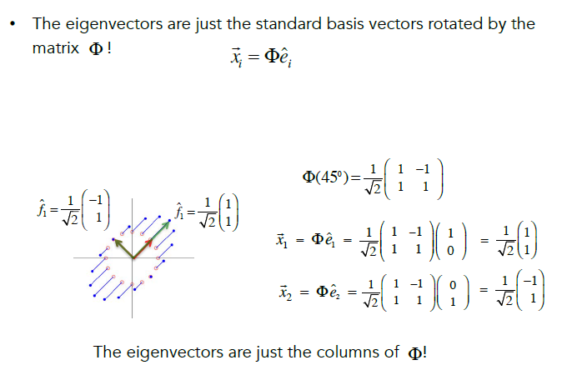
Eigenvectors and eigenvalues

Slide 30
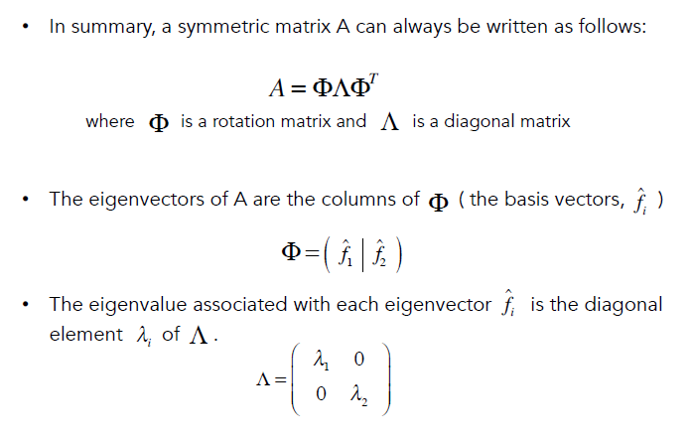
Eigenvectors and eigenvalues

Slide 31
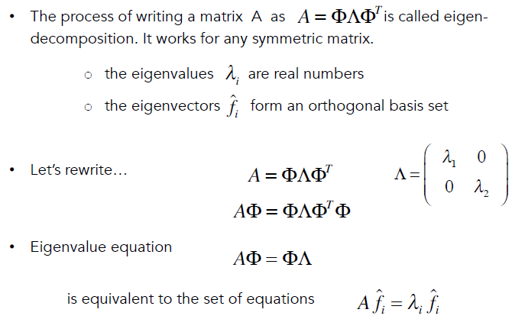
Eigen-decomposition

Slide 32
Variance and multivariate Gaussian distributions

Slide 33
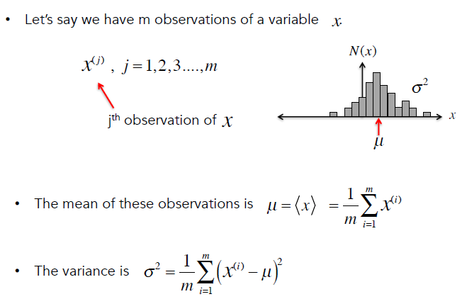
Variance

Slide 34
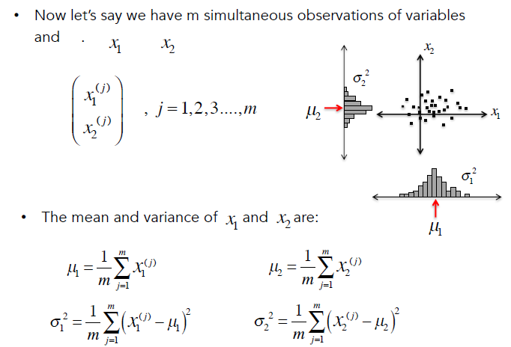
Variance

Slide 35
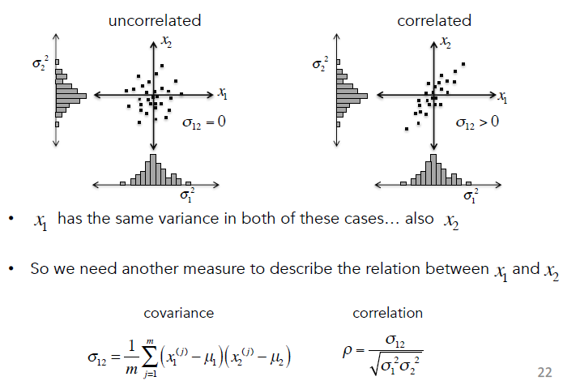
Covariance

Slide 36
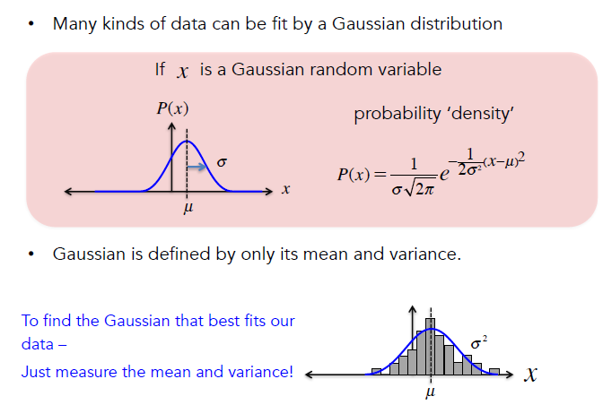
Gaussian distribution

Slide 37
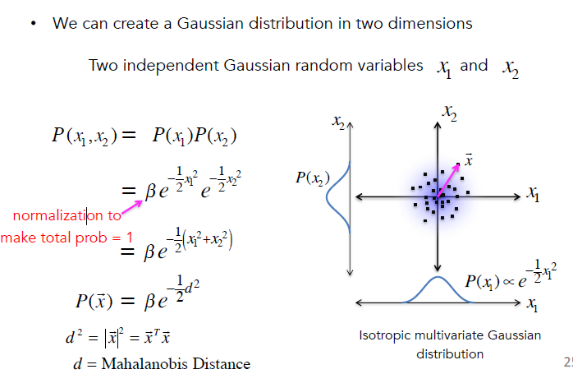
Multivariate Gaussian distribution

Slide 38
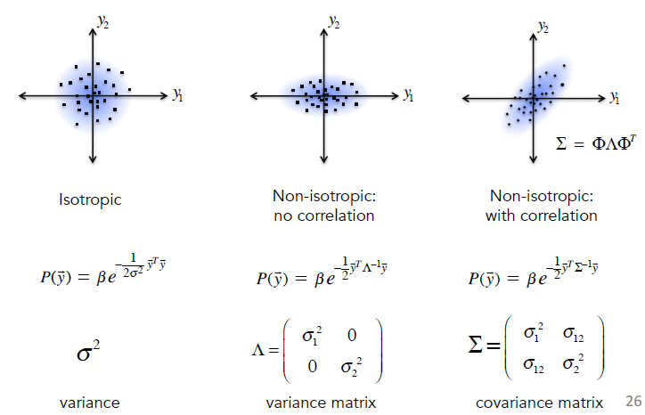
Multivariate Gaussian distribution

Slide 39
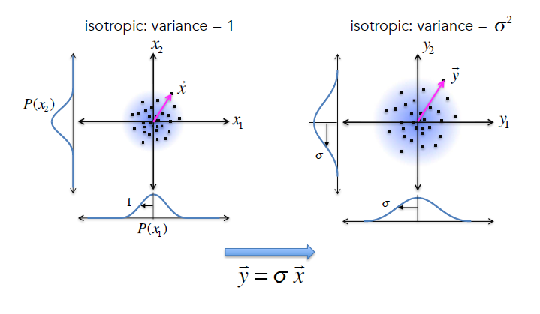
Multivariate Gaussian distribution

Slide 40
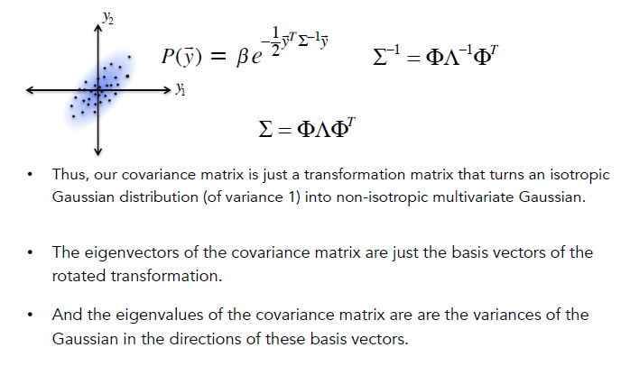
Eigen-decomposition Covariance matrix

Slide 41
Computing a covariance matrix from data

Slide 42
In class Activity
Colab notebook
Make sure you download it and then upload

Slide 43
Thank You
Reference:
MIT- 940 Introduction to Neural Computation

